Slide 1
Water Quality Monitoring System
Presented by
SHINY GLADIS S

Slide 2
Design Thinking :
1. Project Objective
* Agriculture is the backbone of our country and it is very important
to know the parameter of soil and water for efficient harvesting.
The various parameters that can be monitered are Soil moisture, pH level
of water, Temperature , etc.
* We previously measured these parameters in different tutorials but today we will not only combining them but also display them on a webpage so that can be monitored from any wherein the world.

Slide 3
2.IOT SENSOR DESIGN :
Analog pH sensor is designed to measure the pH value of a solution and show the acidity or alkalinity of the substance.
It is commonly used in various applications such as agriculture , waste water treatment , Industries , environmental monitoring, etc.
The module has an on-board voltages regulator chip which supports the wide voltage supply of 3.3-5.5V DC which is compatible with 5V and 3.3V of any control board like Ardino.
We previously used a PH sensor with Ardino to measure the Ph values of liquid solution.

Slide 4
3.REAL TIME TRANSIT INFORMATION PLATFORM :
DS18B20 is a single wire temperature sensor, as this can be interfaced with microcontroller or Arduino using single data wire
This is available in a waterproof and Non-waterproof format.

Slide 5
4.INTEGRATION APPROACH
An HTML page for this water monitoring system using IoT is created which has HTML table to show pH value, temperature and soil moisture
Check for valid JSON data reception , from the transmitter side data assigned to individual variables and appended in the HTML webpage for real time display

Slide 6
5.BLOCK DIAGRAM
Arduino UNO
Node MCU
Gravity analog pH sensor
DS18B20 temperature sensor
Soil moisture sensor
Power supply
Jumpers
Bread board

Slide 7
BLOCK DIAGRAM
Input Module
OUTPUT MODULE
POWER SUPPLY
BREAD BOARD
ARDUINO UNO
NODE MCU
JUMPERS
GRAVITY ANALOG pH SENSOR
DS18B20 TEMPERATURE SENSOR
SOIL MOISTURE SENSOR
DISPLAY DEVICE(MOBILE)

Slide 8
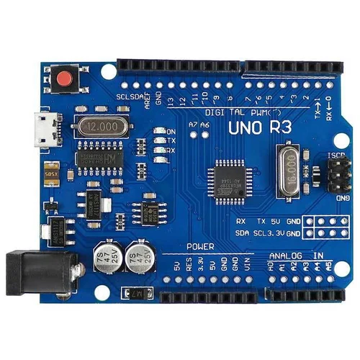
Arduino UNO
Data Collection
Data Processing
Data Logging
Wireless Communication
Automation
User Interface:
Low-Power Mode

Slide 9
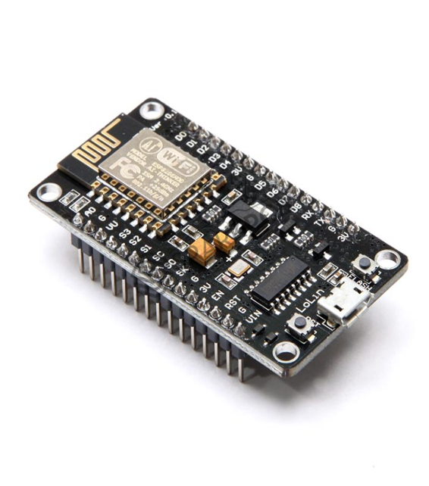
Node MCU
Sensor Interface
Data Collection
WirelessCommunication
Data Logging
Remote Monitoring
Real-time Alerts

Slide 10
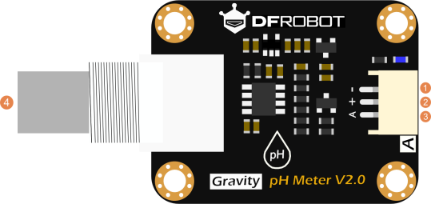
Gravity Analog pH sensor
Analog Output
High Accuracy
Easy to Use
Calibration
Wide Applications

Slide 11
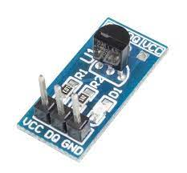
DS18B20 temperature sensor
Calibration
Temperature Measurement
Data Logging and Analysis
Environmental Monitoring
Energy Efficiency
Early Warning System

Slide 12
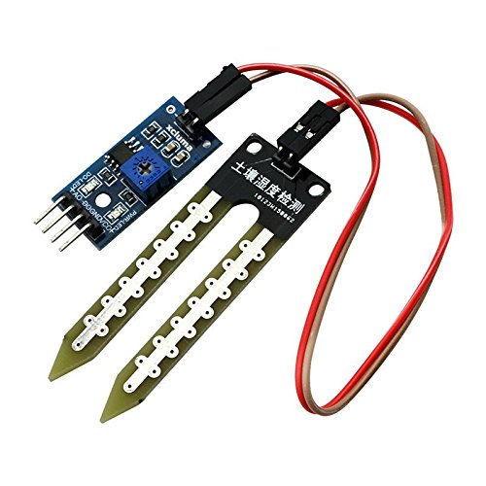
Soil Moisture Sensor
Groundwater Monitoring
Flood Monitoring
Irrigation Management
Watershed Monitoring
Wetland
Aquatic Ecosystem Monitoring
Erosion Control
Water Conservation in Landscaping
Remote Sensing

Slide 13
Power supply
Low-Power Components:
Choose sensors, microcontrollers, and communication modules that are energy-efficient. Low-power components extend the system's battery life significantly, reducing the frequency of battery replacements or recharging.

Slide 14
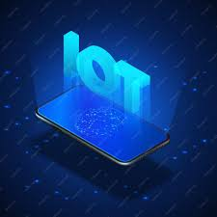
DISPLAY DEVICE
An android app is developed using the MIT app inverter tool.
This app provides a feature to visualize,monitor and analyze via mobile.

Slide 15
Python code
import random
import time
import matplotlib.pyplot as plt
class WaterQualityMonitor:
def __init__(self):
self.timestamps = []
self.ph_values = []
self.turbidity_values = []
def collect_data(self):
while True:
timestamp = time.strftime("%Y-%m-%d %H:%M:%S")
# Simulate sensor data (replace with actual sensor readings)
ph = round(random.uniform(6.5, 8.5), 2)
turbidity = round(random.uniform(0.1, 50.0), 2)
self.timestamps.append(timestamp)
self.ph_values.append(ph)
self.turbidity_values.append(turbidity)
time.sleep(5) # Simulate data collection every 5 seconds
def plot_data(self):
plt.figure(figsize=(12, 6))
plt.plot(self.timestamps, self.ph_values, label='pH')
plt.plot(self.timestamps, self.turbidity_values, label='Turbidity')
plt.xlabel('Timestamp')
plt.ylabel('Value')
plt.title('Water Quality Monitoring')
plt.legend()
plt.xticks(rotation=45)
plt.show()
if __name__ == "__main__":
monitor = WaterQualityMonitor()
monitor.collect_data()

Slide 16
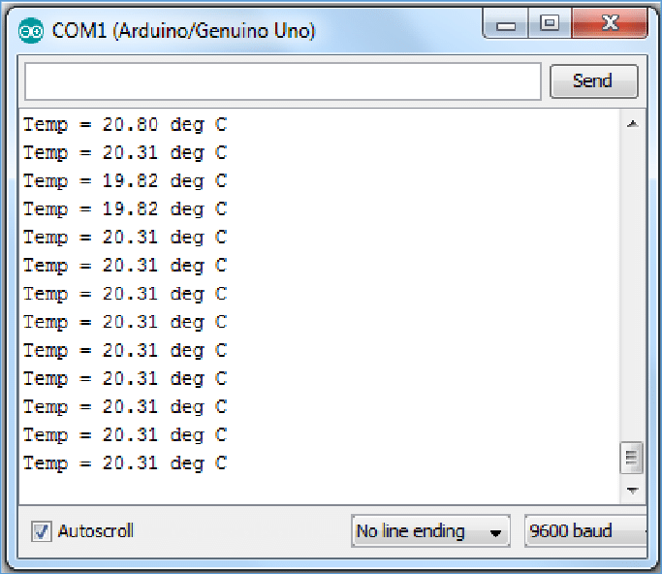
OUTPUT

Slide 17
Water monitoring has various uses:
1. Irrigation Management: Monitoring water quality helps farmers ensure that the water used for irrigation is suitable for crop growth. It can detect harmful substances like salinity or contaminants that might harm corps
2. Soil Health: Water quality affects the health of the soil. Monitoring helps farmers maintain the proper balance of nutrients and prevent soil degradation due to excess salts or toxins in the water.arm crops.
3. Livestock Health: Water quality is crucial for the health of farm animals. Monitoring ensures that the water provided to livestock is free from harmful substances and pathogens.
4. Environmental Protection: It helps prevent pollution of nearby water bodies, as runoff from agricultural areas can contain fertilizers, pesticides, and sediment. Monitoring ensures compliance with environmental regulations.
5. Crop Protection: Detecting contaminants and pathogens in irrigation water can prevent diseases in crops, reducing the need for costly treatments.

Slide 18


